Slide 1

Real-time Software Engineering
(RTSE)
Department of software engineering
Faculty of Computing
UTM

Slide 2

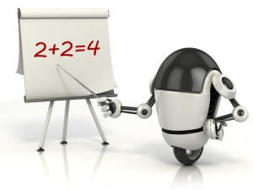
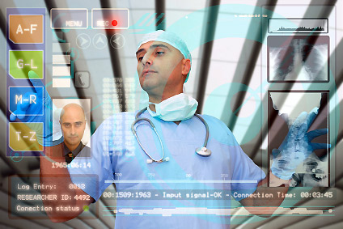

Introduction
Current and future technology
Tips
How to develop this system with a proper software engineering concept?

Slide 3
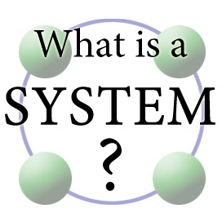
Introduction
What is real time system?
What is embedded system?
What is the relationship between real-time system and SE?
Characteristics of real-time system
Challenges in RTSE
Input
Process
Output
Tips
Understand the concepts

Slide 4
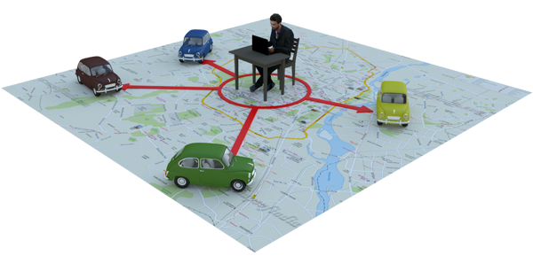
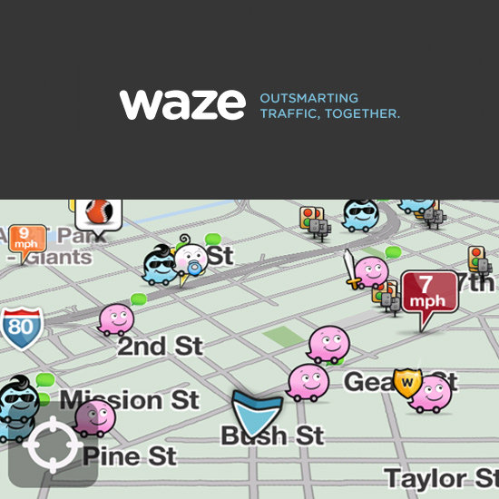
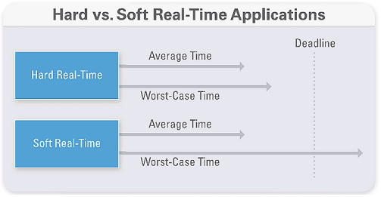
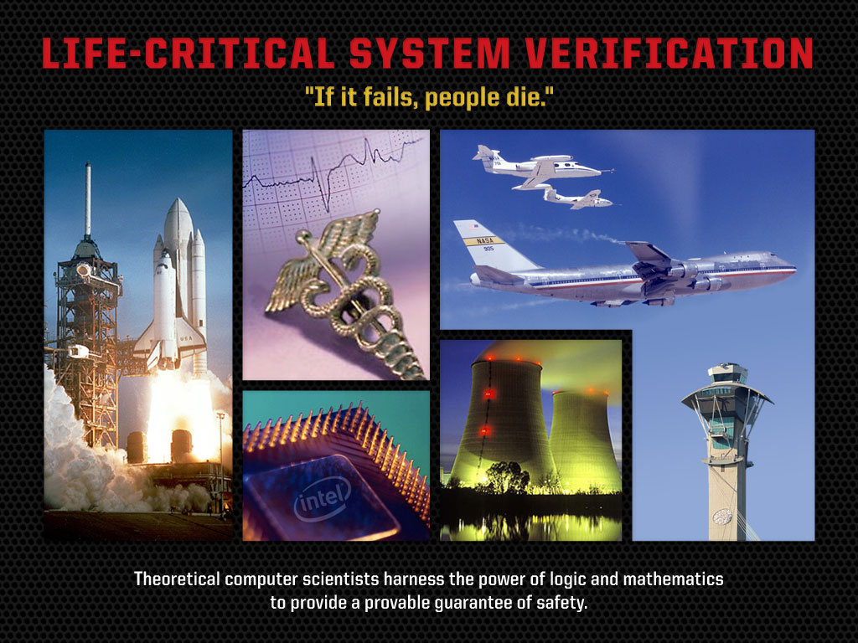
Introduction
What is real time system?
Correctness is depending on TIMING
Timing
requirements
Missed deadline could lead
severe consequences
Tips
Understand the concepts of real time
Notes:
Responsiveness in real-time is the critical difference between embedded systems and other software systems, such as information systems, web-based systems or personal software systems.
For non-real-time systems, correctness can be defined by specifying how system inputs map to corresponding outputs that should be produced by the system.
In a real-time system, the correctness depends both on the response to an input and the time taken to generate that response. If the system takes too long to respond, then the required response may be ineffective. Hard real time system
Response time to incoming events must be guaranteed even under extreme conditions
Missed deadlines lead to severe consequences, eg flight control systems may cause loss of human life,
Correctness is critical.
Soft real system
Can miss events’ deadline and still function within parameters
Here, overall performance is central concern but individual activity deadlines are not critical
Failure may still be tolerable

Slide 5
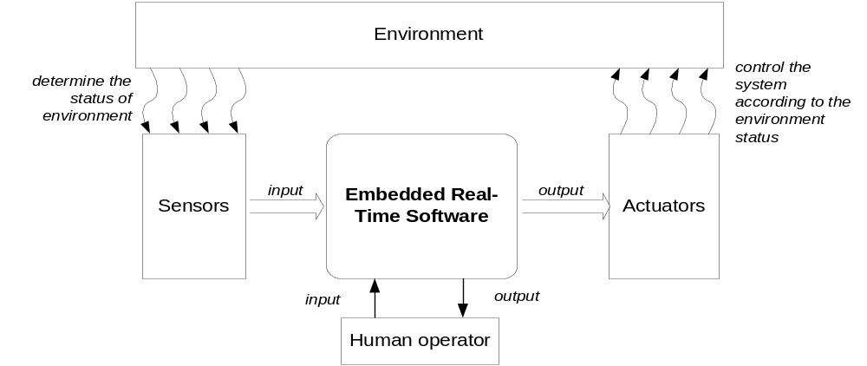
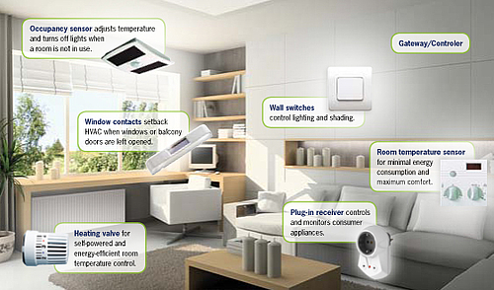
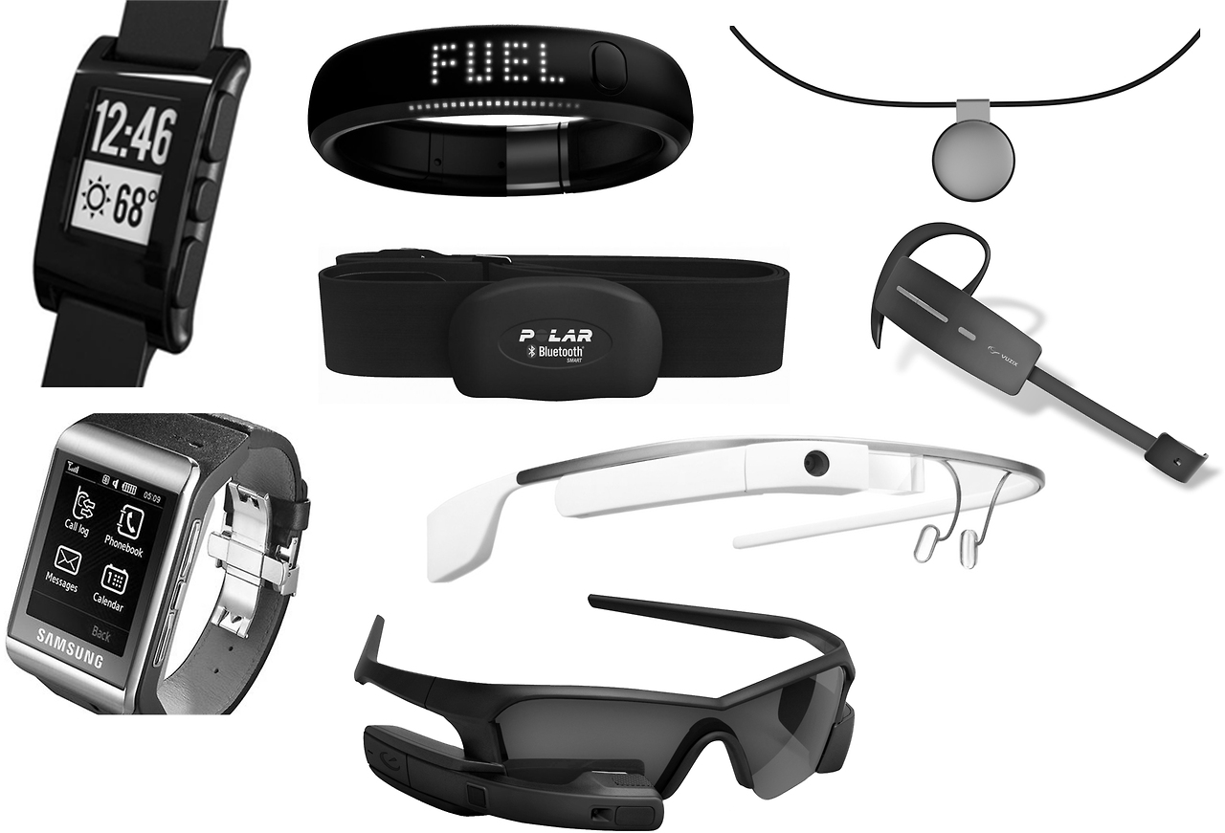
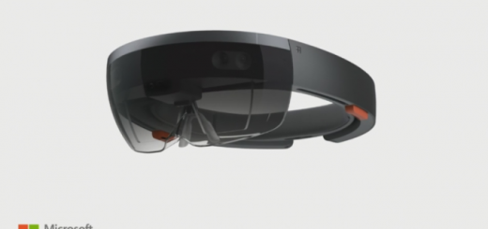
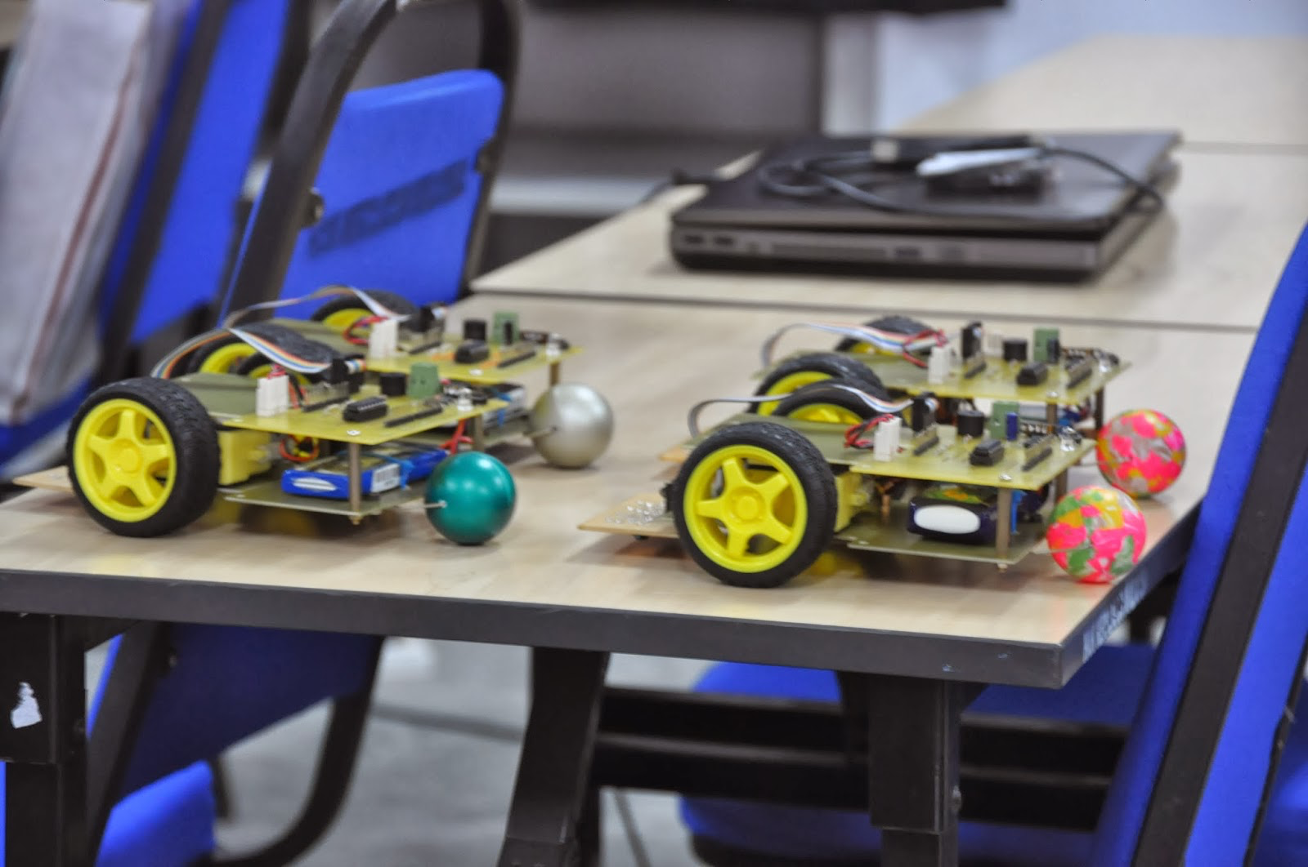
Introduction
What is embedded system?
Tips
Understand the concepts of embedded systems
Notes:
Embedded system is a system, which contains microcomputer as a component, but the user does not see the system as a computer.
Embedded System provides the major part of necessary technology for new trends of computing in:
Ubiquitous/ pervasive computing - “information anytime, anywhere”
ambient intelligence - utilizes communication technology in future homes and smart buildings
Embedded System frequently connects to environ-ment through sensors & actuators.
Thus, has an immediate impact on the environment. For safety critical embedded systems h/w & s/w must be dependable.

Slide 6
Introduction
What are the differences?
ERTS vs non-ERTS
Dedicated to specific task
RTS vs non-RTS
Deadlines
Faults leads to major loss
Many processor
Cost sensitive
Deal with exceptions
Predictable, fast, reliable, adaptive
Dedicated RTOS
Failure leads to major loss
Constraints on resources and size
Dedicated tools for development
Tips
Differences between RTS and non-RTS as well as ERTs and non-ERTs
Notes:
Have deadlines attached to some or all tasks
Faults in the system may lead to catastrophic
Must have the ability to deal with exceptions
Must be fast, predictable reliable, adaptive
ERTs are dedicated to specific tasks, whereas PCs are generic computing platforms.
ERTs are supported by a wide array of processors and processor architectures.
ERTs are usually cost sensitive.
Implementation constraints in ERTs are real-time, resources and size.
If an ERTs is using an OS at all, it is most likely using a real-time operating system (RTOS).
The implications of software failure is much more severe in ERT than in desktop systems and run continuously.
ERT require specialized tools and methods to be efficiently designed.

Slide 7
Characteristics of RTSE
What are the main characteristics of RTSE?
Sensors
(inputs)
ERT software
Actuators
(outputs/response)
Tips
RTSE characteristics

Slide 8



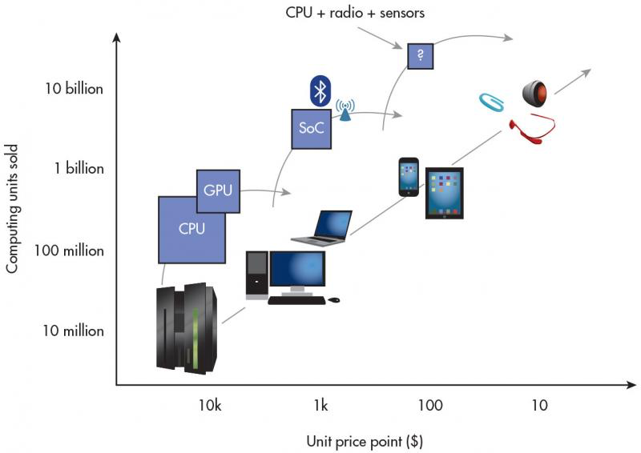

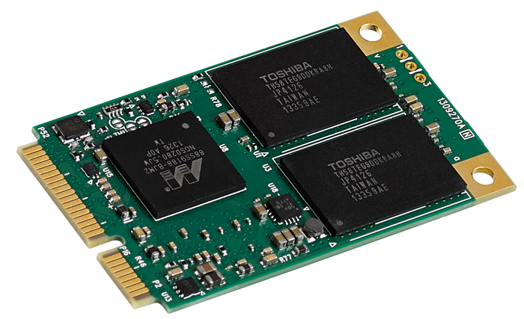

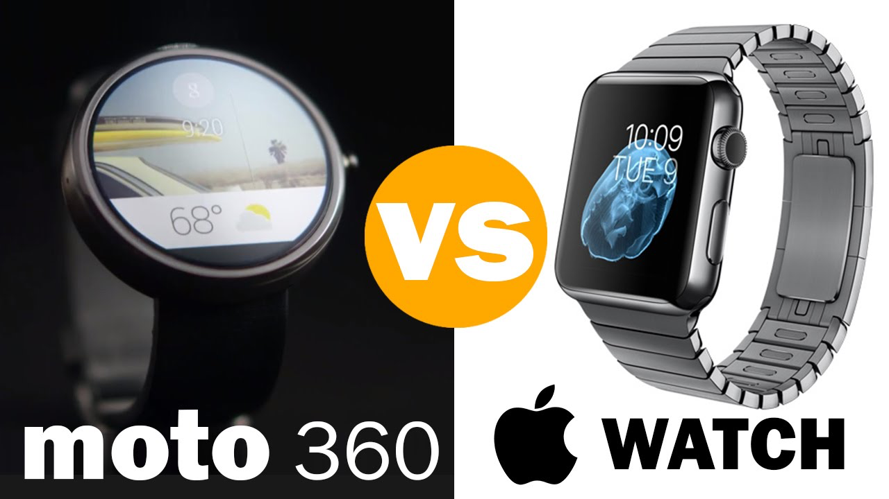
Characteristics of RTSE
Timeliness
Reliability
Concurrency
Intensive dynamics
Characteristics of
RTSE
Resource allocation
Exception handling
Communication and synchronization
size
Tips
RTSE charateristics
Notes:
Timeliness
Reaction to stimuli “on time” (deadlines must be met)
Relative and absolute timing constraints
Reliability
Many errors have roots in incorrect specification
Formal techniques needed for safety-critical systems
Intensive dynamics
Models to describe behavior are necessary (based on finite state machines).
Systems can adapt to situation changes
Exception handling
Priorities should be assigned to stimuli/events
Mechanisms for handling interrupts need be developed
Concurrency
Parallel tasks are inherent in RTS
The environment is also “concurrent” in nature
Distribution & resource allocation
Distribution is not necessarily a characteristic of RTS, but should be taken into consideration in larger applications
Communication and synchronization
Synchronous and asynchronous communication mechanisms should be designed
Size
In larger applications, there are numerous processes and threads
Size is associated with continuous change
Decomposition in smaller units is needed, as are mechanisms for modeling hierarchical structures

Slide 9
Challenges in RTSE
Challenge: Timing issues are not properly addressed
Challenge: RTOS and RT scheduling is difficult to adapt
Challenge: Theories, method and tools
Timeliness
Heterogeneity
Concurrency
Reliable
Evolve
Challenge: Process and tool supports is not properly developed
Challenge: Requirements and design
Tips
Understand the characteristics and challenges of RTSE

Slide 10
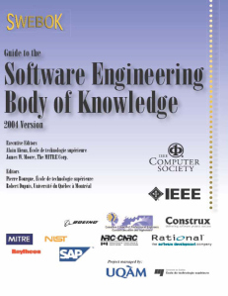



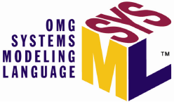
Real time AND Software Engineering
Military
Healthcare
Real-time
system
System
Development/
Software engineering
concepts
Forecasting
……
Domain
Software/hardware
Product
Theories
(real time OS,
Scheduling)
Methods
Tools
Tips
The relationship

Slide 11

Self-test
What are the relationship between Embedded
Real-time System and IOT, Data analytics and
Artificial Intelligence?
2. What are the possible solutions of ERTS for
healthcare domain?
Tips
RTSE

Slide 12
RTSE
Thank You
Tips
RTSE

